Slide 1
Properties of DNA Polymerases
Lecture - 12
Adds nucleotides in 5’ to 3’ direction
Requires a template and a primer
Extremely accurate
Also has proof-reading activity to correct errors
Very fast reaction due to processive nature
Why DNA needs to be repaired?
The error rate during DNA replication is as low as 10⁻⁹ to 10⁻¹¹ errors per base pair

Slide 2
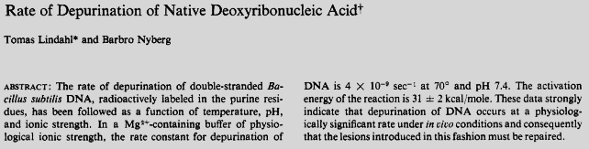
DNA damage and repair
Because each cell contains only one or two copies of its DNA, maintaining integrity of the DNA is very important.
In the early 1970s, scientists believed that DNA was an extremely stable molecule, but Tomas Lindahl demonstrated that DNA decays at a rate that ought to have made the development of life on Earth impossible.
Biochemistry. 1972 Sep 12;11(19):3610-8.
Notes:
Depurination is a chemical reaction of purine deoxyribonucleosides, deoxyadenosine and deoxyguanosine, and ribonucleosides, adenosine or guanosine, in which the β-N-glycosidic bond is hydrolytically cleaved releasing a nucleic base, adenine or guanine, respectively.

Slide 3
Tomas Lindahl, Nobel Lecture

Slide 4
Fragility of DNA
DNA is a relatively stable molecule, but Earth’s natural environment is quite toxic, and damage to DNA is inevitable.
DNA is also susceptible to reactive oxygen species (ROS) generated within the cells.
DNA can also be altered by mistakes made during its own replication or recombination.
Damage and sequence alterations to DNA are often quickly repaired, but when they are not, the DNA becomes permanently altered and harbors a mutation.
Mutations are changes in DNA sequence, and when mutations occur in germ-line cells, these changes are inheritable.

Slide 5
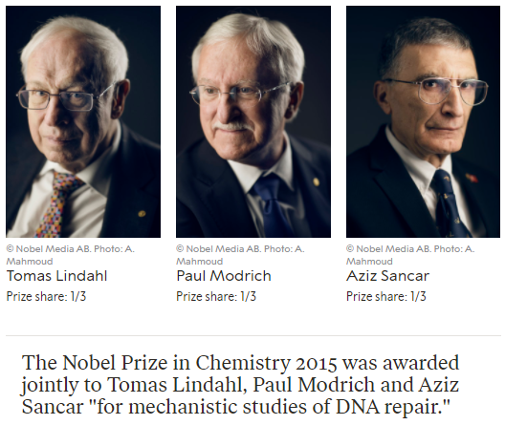

Slide 6
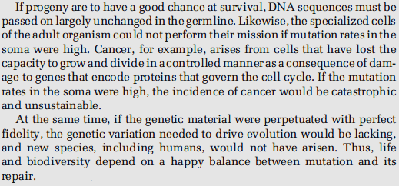
Molecular Biology of the Gene, 7th Edition

Slide 7
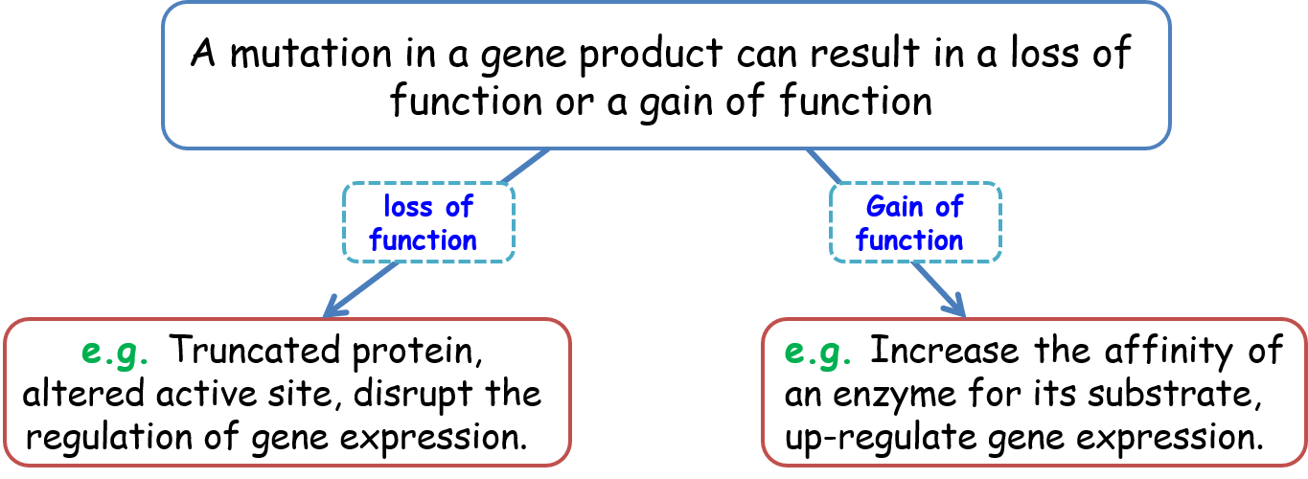
Loss and gain of function mutations
Notes:
Studies in Drosophila melanogaster suggest that mutations that alter the protein sequence are most likely to be harmful; about 70% have a negative effect, and the rest either are neutral or have a weak beneficial effect.

Slide 8
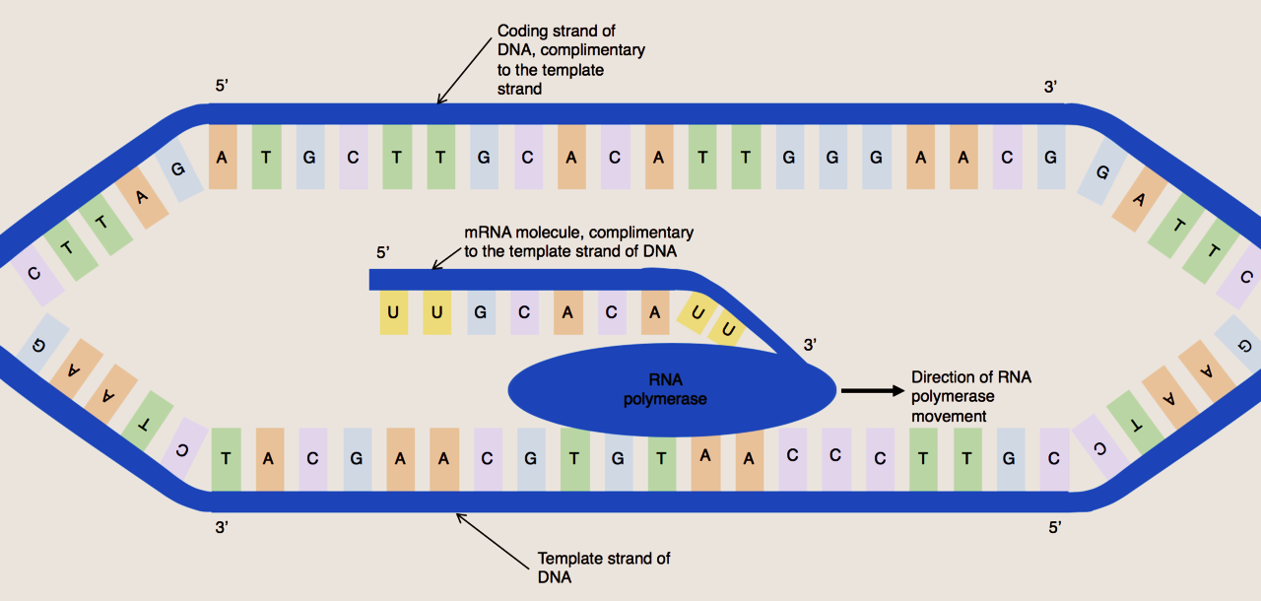
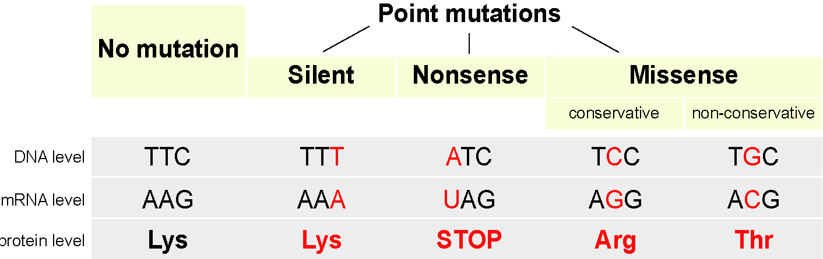
Types of point mutations

Slide 9
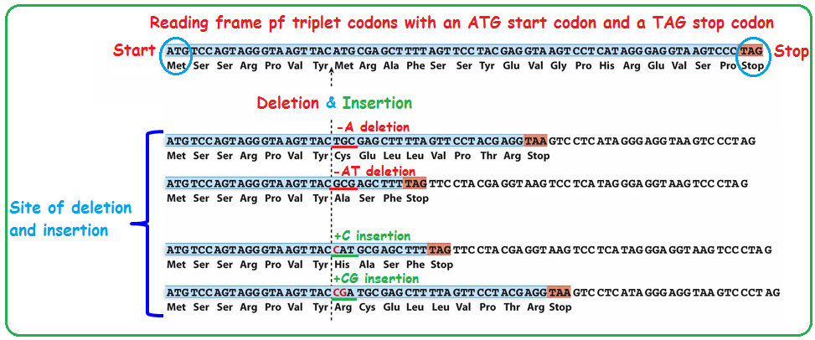
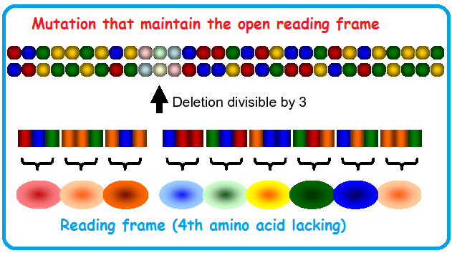
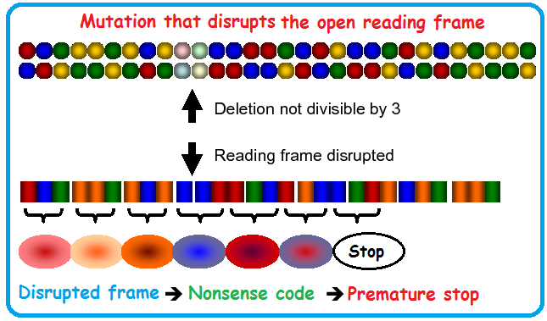
Frameshift mutations

Slide 10
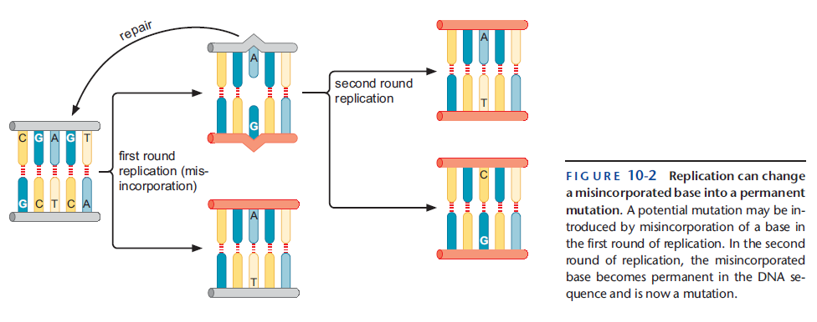
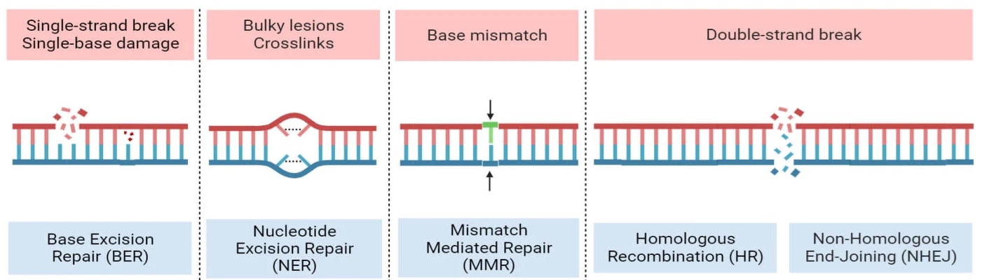
DNA damage vs DNA mutation

Slide 11
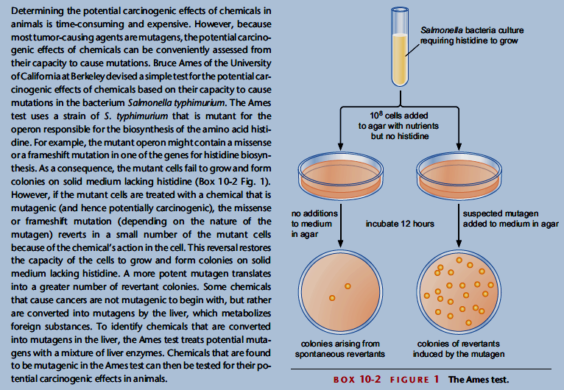
Chemical mutagens: Ames Test

Slide 12
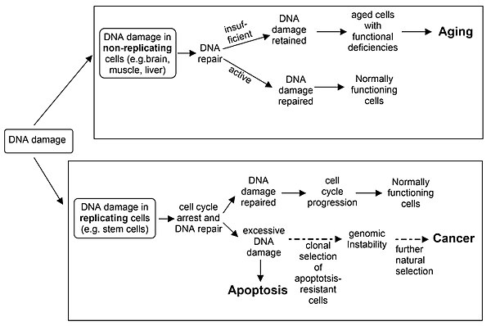
Consequences of DNA damage/mutation

